Slide 1


World Cup Data Analysis
Integrating Data Analytics,Python, Power BI Visualization, and an AI Chatbot
GITHUP

Slide 2





WORLD CUP
Project Overview
Data Cleaning & Preparation
Data Modeling
Removing duplicates, fixing missing or inconsistent values, correcting data formats, and standardizing fields to ensure the dataset is accurate, consistent, and ready for reliable analysis
The process of structuring cleaned data into logical relationships and tables, defining measures and dimensions to enable accurate analysis, reporting, and efficient querying in tools like Power BI .
This project focuses on analyzing World Cup data using Python, Power BI.
The goal was to clean, model, and visualize the data, then build a chatbot that can answer questions about it using Gemini API.
Combines both Data Analytics and Artificial Intelligence.
Insights & Findings
Power BI Dashboard
Insights and findings are the meaningful conclusions drawn after analysis, highlighting trends, patterns, anomalies, or opportunities that directly support decision-making and business actions
Used slicers to allow users to filter by Year, Country, Team, or Group. Added interactive tooltips for deeper context. Structured layout across different pages (e.g., Overview, Teams, Matches, Goals, Bookings)

Slide 3
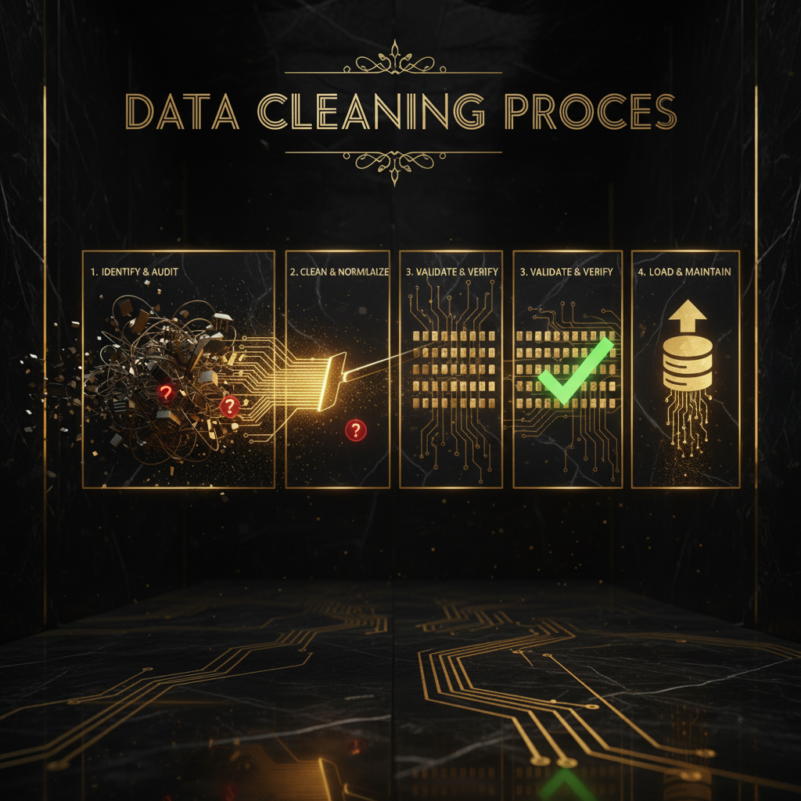
WORLD CUP
Data Cleaning & Preparation
Merged related columns (e.g., home_team + away_team, win/lose/draw).
Removed duplicate columns (replay, replayed).
Fixed spelling and encoding errors (e.g., quater-finals → quarter-finals, â€“ → -).
Standardized group names (A, B, C).
Ensured each match appears exactly twice using Group By (match_id).
In Players: created full_name, cleaned birth_day, split tournaments, extracted positions.
In Goals: removed redundant text columns, replaced invalid shirt_number, merged goal_type, and added goal_side

Slide 4
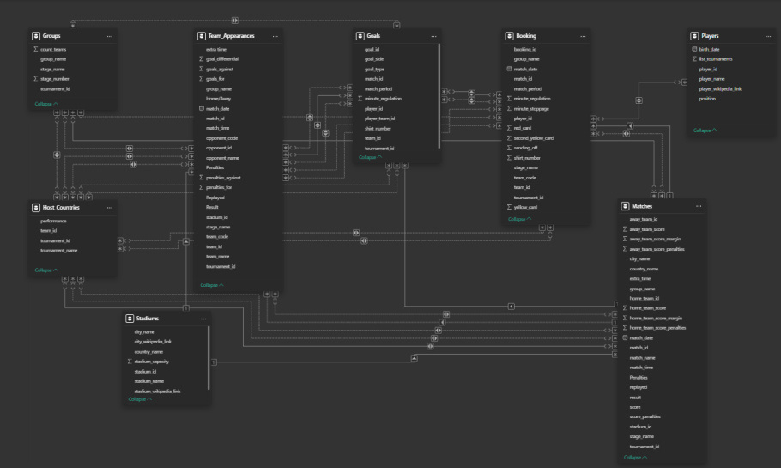
WORLD CUP
Data Modeling
Built relationships between multiple tables using common keys (team_id, match_id, etc.).
Created a well-structured data model to ensure smooth analysis and accurate insights.
Used Power BI relationship view instead of SQL joins or views.
Ensured all tables were connected properly to support DAX calculations and KPIs.

Slide 5
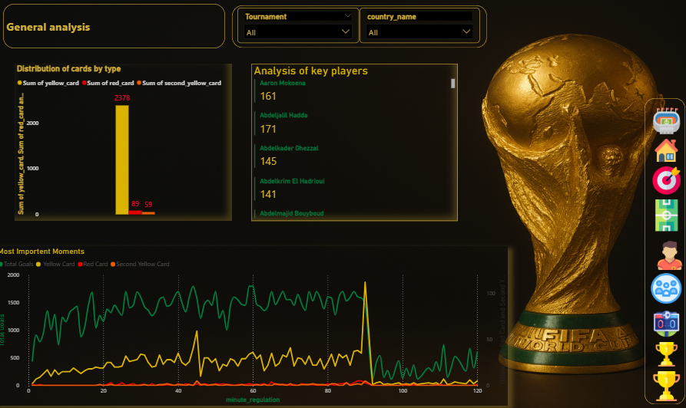
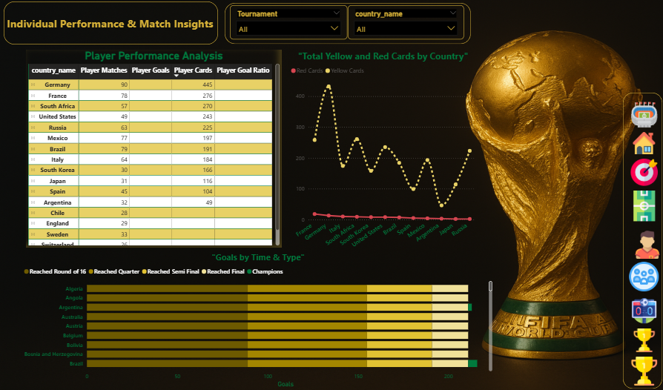
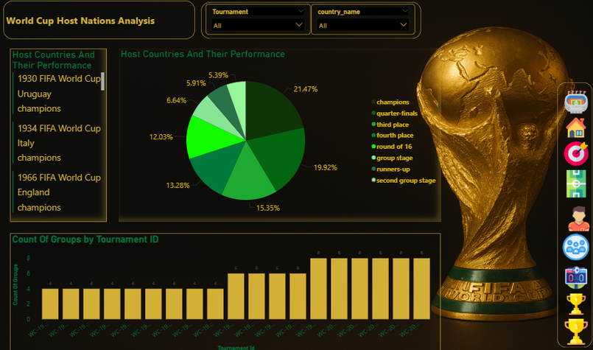
WORLD CUP
Power BI Dashboard
Developed an interactive dashboard in Power BI.
Included KPIs such as:
Total Sales / Total Goals
Average Performance
Top Teams / Top Players
Added slicers and filters for tournaments, years, and teams.
Used bar, pie, and line charts for visual insights.

Slide 6
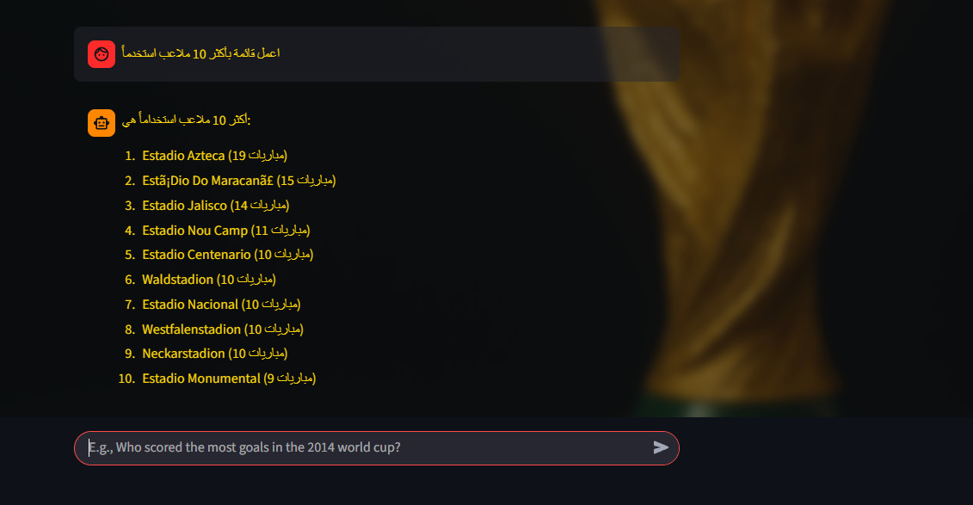
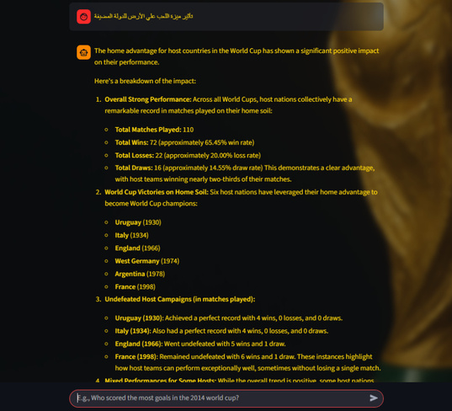
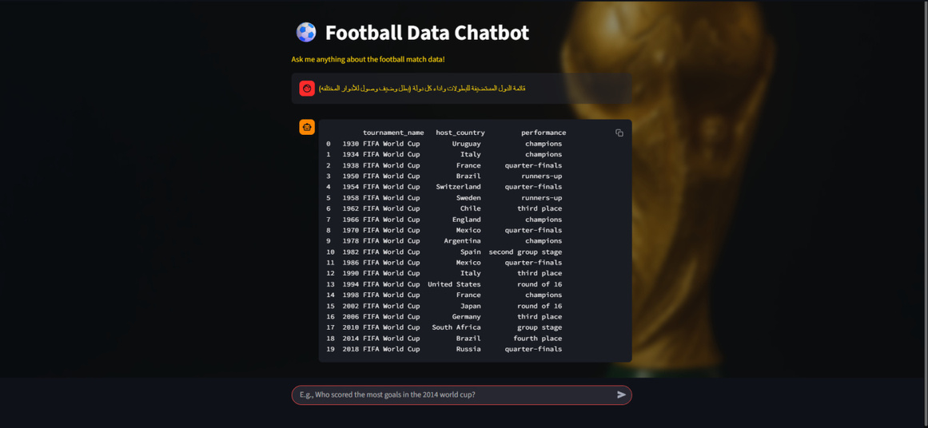
WORLD CUP
Insights & Findings
Our interactive chatbot provides instant access to a comprehensive FIFA World Cup dataset, allowing users to move beyond raw data to uncover meaningful trends and statistics through simple, conversational queries
Direct Data Queries
Automated Ranking & Aggregation
In-Depth Analytical Insights
This tool transforms a static dataset into a dynamic source of knowledge, making complex football history accessible to everyone.

Slide 7




WORLD CUP
👥 Team Members
Mohamed Kassab
Mohamed Salah
Mostafa Ashraf

Slide 8



WORLD CUP
👥 Team Members
Mostafa Mohamed
Mahmoud Ayman
Mohamed Othman

Slide 9



WORLD CUP
👥 Team Members
Omar Ashraf
Islam Mohamed
Omar Makram

Slide 10

THANK YOU

